Slide 1

Smart-Home Project
Presented by:
Shady Aly Soltan
Mohamed Bakr Abd El Salam

Slide 2
Introduction
It is a popular project nowadays, it is a very comfortable application for humans, it aims to convert anything around to be controllable and smart. This technology makes life easier for the users and more comfy for them. A home automation system can involve switching off electrical appliances like air-conditioners or lights or when a desired temperature has been reached, then switching on again when the temperature has crossed a certain value. A home automation system can also be used to secure a house from burglars.

Slide 3
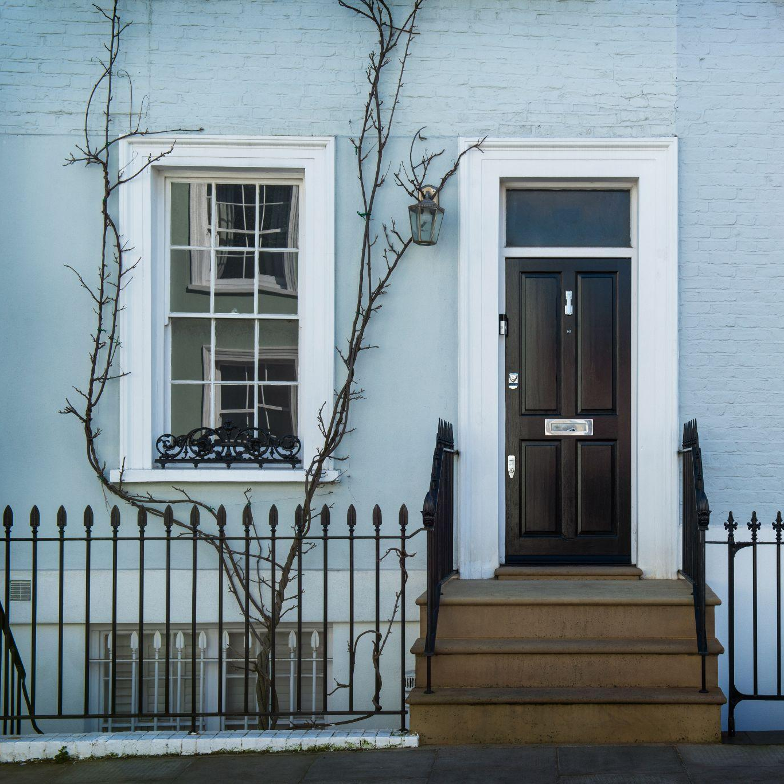
Our Project
In our project, we’ve implemented multiple features, first you can either use:
Admin Mode
User Mode
The admin mode is controlled by mobile phone while the user mode is controlled by the LCD and Keypad. You can only use the user mode by giving permission from the admin.
The main difference from the admin and user is that the admin can control the main door by closing or opening it from a command from your mobile phone.

Slide 4
How the system works

Slide 5
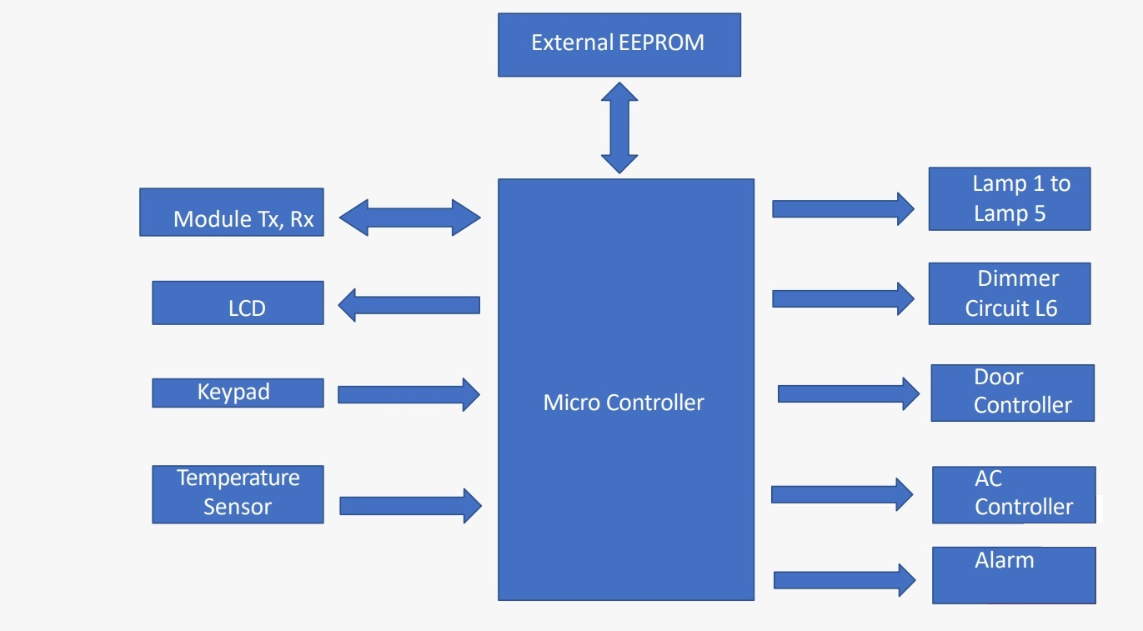
Block diagram

Slide 6

After paring your phone, the connected phone will be the admin mode and will be givien choices to either control the door or the rooms inside the house. If switched to the user mode it will either make the user(“register if first time using the app” or “Login”). If the user user entered the password wrong 3 times the alarm will fire!.

Slide 7
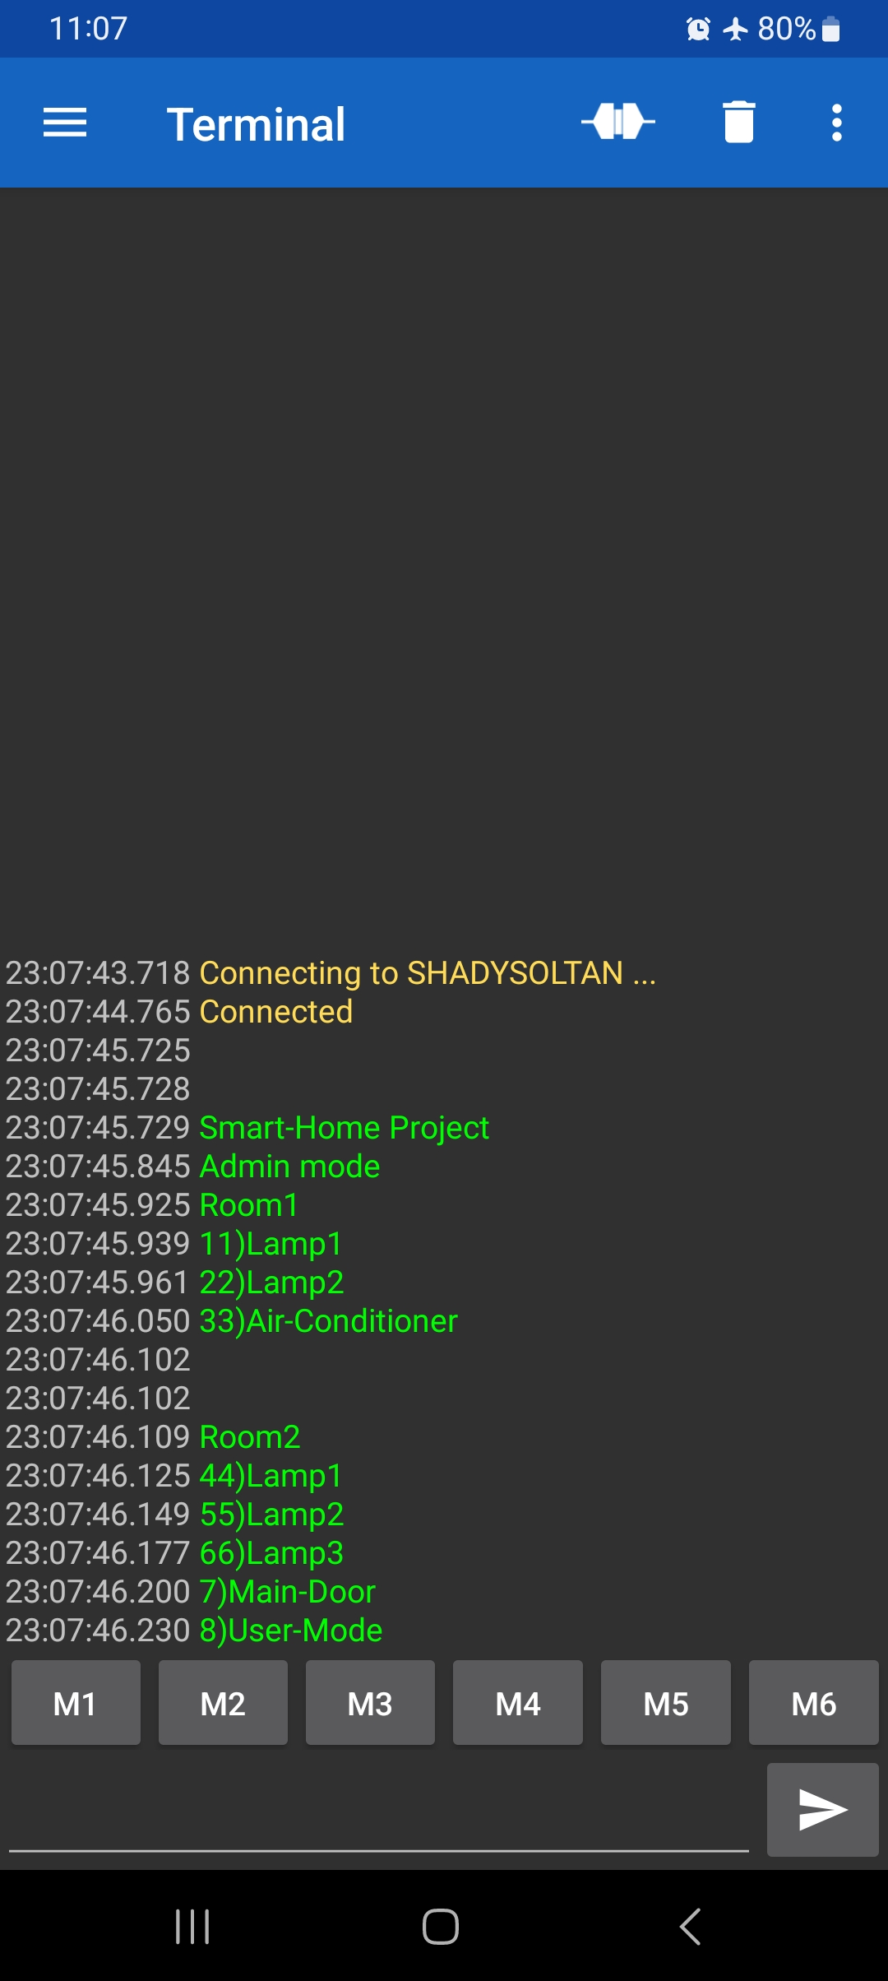
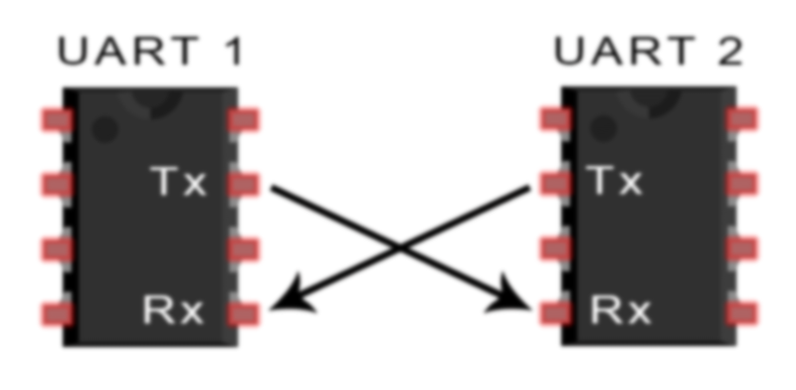
The admin mode
UART Communication:
Transmitting/Receiving between MC and PC/mobile.
Every action, Message is printed on Mobile/PC screen.
Transmitting/Receiving the commands to run the system

Slide 8
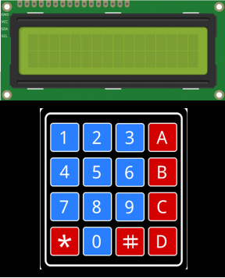
User Mode:
The user mode will be controlled from the LCD and keypad if givien permession from the admin. If it is the first time to login a user you will be asked to register by enterning a new password and then confirm it again. After chosing the desired password it will be saved in an external EEPROM 24aa16 using I2C communication protocol with the Master MCU. After this step, you can login everytime using this password and start controlling both rooms one and two.

Slide 9
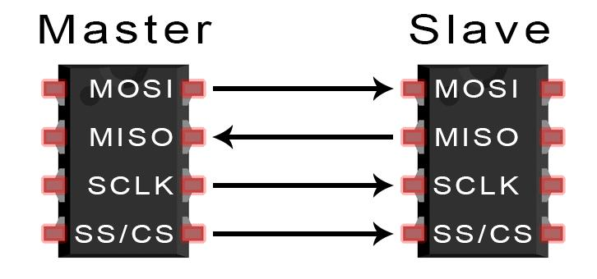
The SPI communication
In this project two MCUs were used, both are “ATmega32” both of them communicate together using SPI communication protocol. Special commands were used to communicate between Master and Slave and these commands can be modified in the app.h file. The Slave MCU will be waiting for the initiation of the communication from the Master MCU to take a specific command to do specific function.

Slide 10
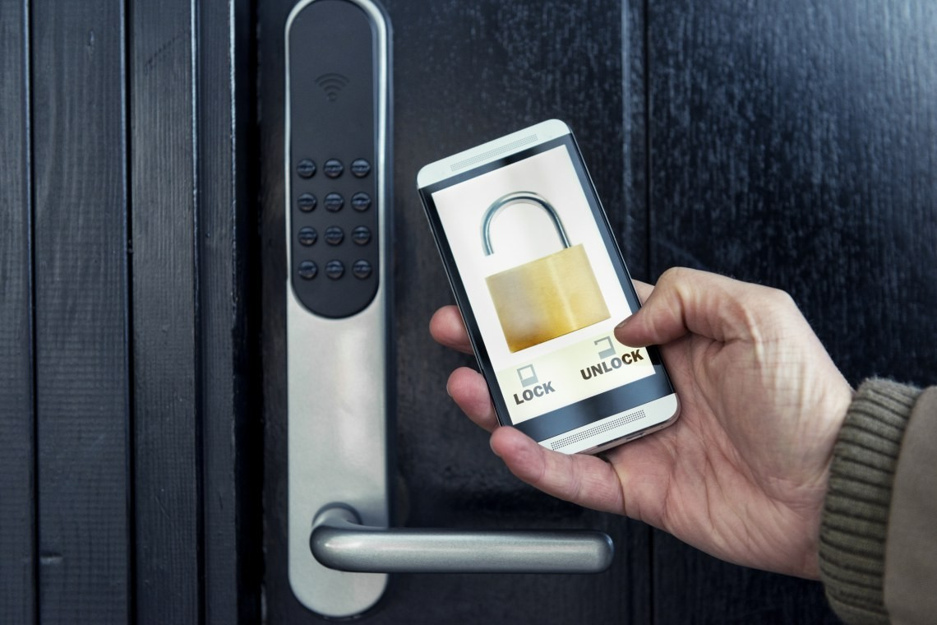
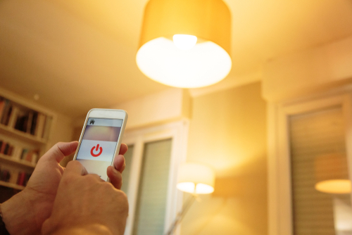
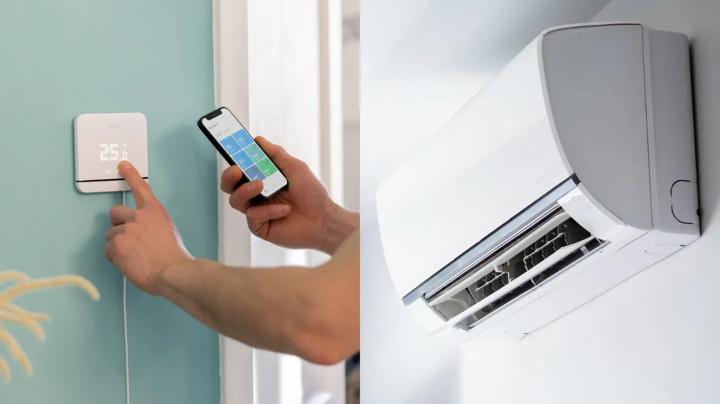
Controllable components
The main door: used a servo motor connected to the Master MCU and timer1 to provide PWM signal for it to open or close and store 1 in an specefic location in the EEPROM if opened and 0 if closed.
5 Lamps: 2 were used in room1 and the other 3 are used in room 2, one of them can be dimming using a potentiometer all of them are connected to the Slave MCU, you can turn them on/off using the SPI by sending commands from the Master.
Air Conditioner: Connected to the Slave MCU, once turned on it will use timer1 to check the ADC every approximately one second. It can be on if it is already working or stand by waiting for the temperature to rise again.

Slide 11
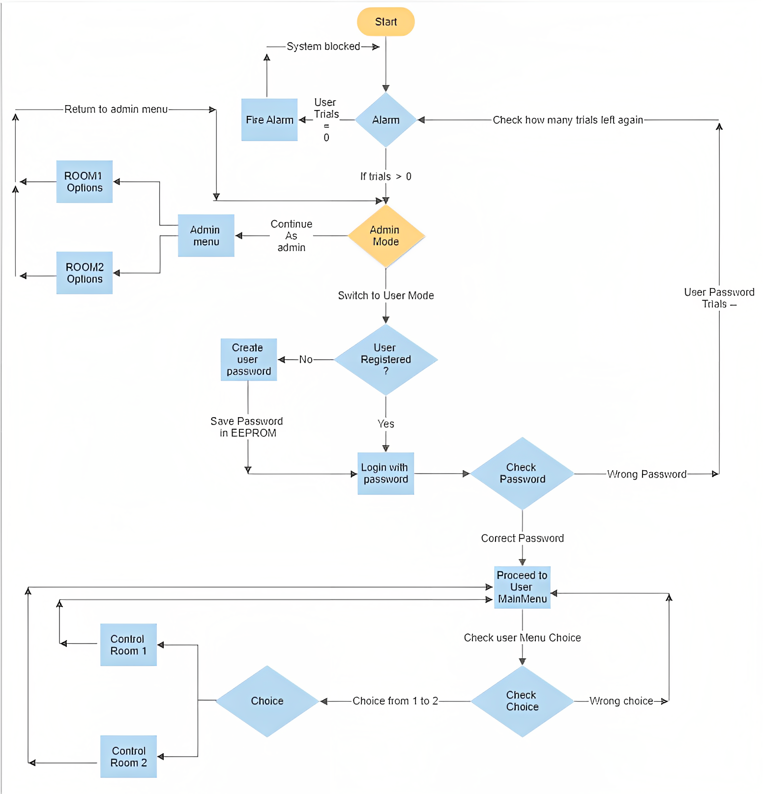
Flowchart

Slide 12
Thank You!

